Slide 1

Huazhong University of Science and Technology
The Department of Electronics and Information Engineering
Electronic Circuit Analysis and Design
Dr. Tianping Deng
Email: dengtp@hust.edu.cn

Slide 2
Contents
PART 1 SEMICONDUCTOR DEVICES AND BASIC APPLICATIONS
Chapter 1 Semiconductor Materials and Diodes
Chapter 2 Diode Circuits
Chapter 3 The Field-Effect Transistor
Chapter 4 Basic FET Amplifiers
Chapter 5 The Bipolar Junction Transistor
Chapter 6 Basic BJT Amplifiers
Chapter 7 Frequency Response
Chapter 8 Output Stages and Power Amplifiers
PART 2 ANALOG ELECTRONICS
Chapter 9 Ideal Operational Amplifiers and Op-Amp Circuits
Chapter 10 Integrated Circuit Biasing and Active Loads
Chapter 11 Differential and Multistage Amplifiers
Chapter 12 Feedback and Stability
Chapter 13 Operational Amplifier Circuits
Chapter 14 Nonideal Effects in Operational Amplifier Circuits
Chapter 15 Applications and Design of Integrated Circuits
Chapter 12 Feedback and Stability

Slide 3
Ch12 Feedback and Stability
12.0 Preview
12.1 Introduction to Feedback
12.2 Basic Feedback Concepts
12.3 Ideal Feedback Topologies
12.4 voltage (Series-Shunt) Amplifiers
12.5 Current (Shunt-Series) Amplifiers
12.6 Transconductance (Series-Series) Amplifiers
12.7 Transresistance (Shunt-Shunt) Amplifiers
12.8 Loop Gain
12.9 Stability of the Feedback Circuit
12.10 Frequency Compensation
12.11 Summary

Slide 4
12.4.1 Op-Amp Circuit Representation
12.4.2 Discrete Circuit Representation

Slide 5



Slide 6

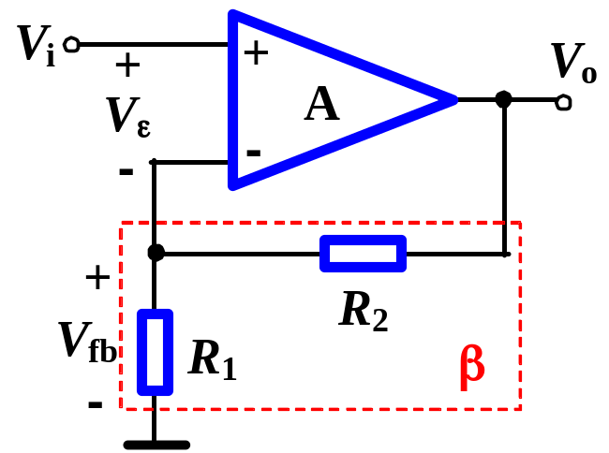
(+)
(+)
Step 1: recognize feedback network
Network_ R₁ and R₂.
(+)
Step 2: determine positive or negative feedback
Instantaneous polarity_neg.
Step 3: determine input connection
KVL can be used, or input and feedback signal are at different terminals. →series
Step 4: determine output connection
When R_{L}=0,→ v_{O}=0, v_{F} is directly proportional to v_{O}, → v_{F}=0, →shunt.
The circuit is a series-shunt neg. configuration.

Slide 7

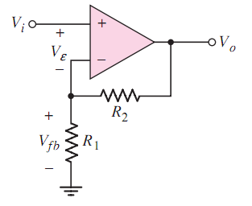
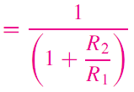





Slide 8
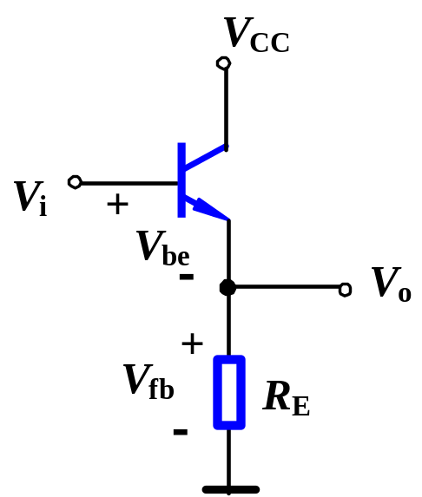
(+)
Step 1: recognize feedback network
Network_ R_{E}.
(+)
Step 2: recognize positive or negative feedback
Instantaneous polarity_negative
Step 3: determine input connection
KVL can be used, or input and feedback signal are at different terminals. →series.
Step 4: determine output connection
When R_{L}=0,→ V_{o}=0, V_{f} is directly proportional to V_{o}, → V_{f}=0, →shunt.
The circuit is a series-shunt neg. configuration.

Slide 9
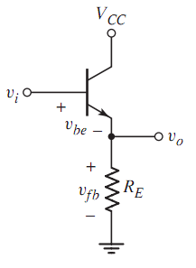


Slide 10
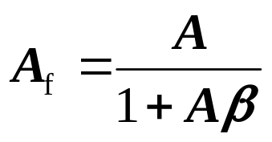
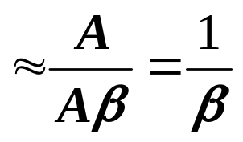
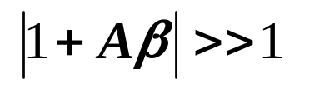
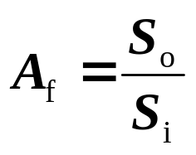
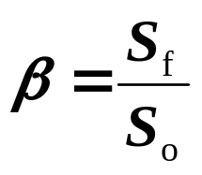



Calculate in an ideal feedback circuit
1. Feature in an ideal feedback circuit
Since
Thus
and
So,
Input is approximately equal to feedback
Net input of basic amp equal zero.
In an ideal feedback circuit, “virtual short and open”can be available.

Slide 11
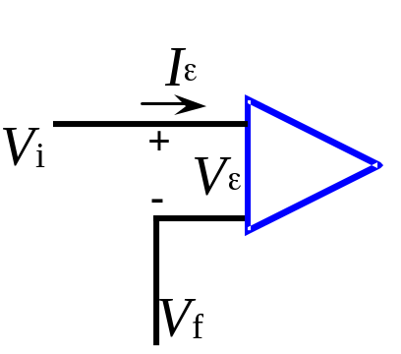
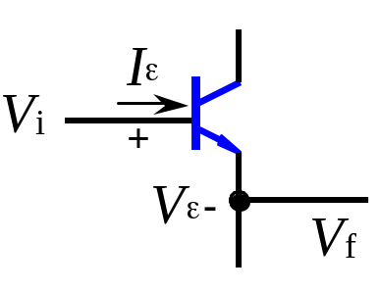

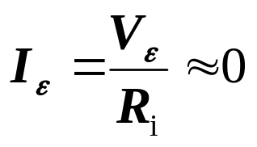
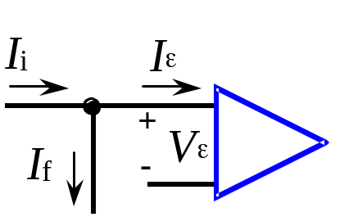
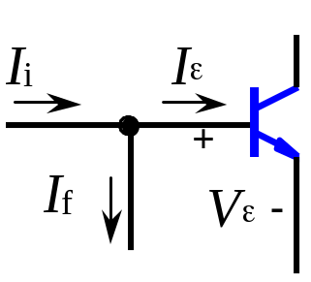


Calculate in an ideal feedback circuit
1. Feature in an ideal feedback circuit
Since
Series input connection
Virtual short
Virtual open
Shunt input connection
Virtual open
Virtual short

Slide 12
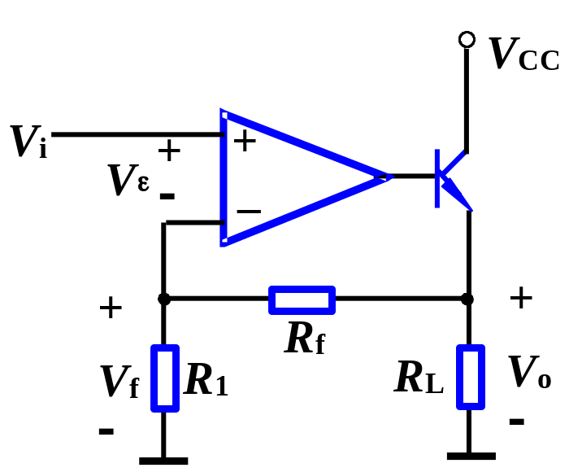


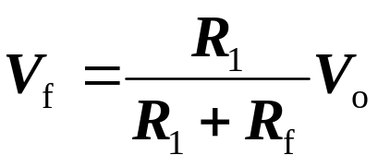
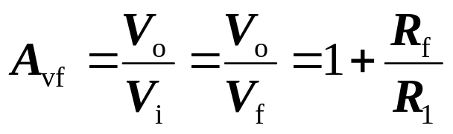
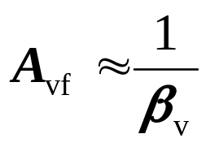
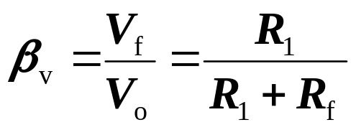
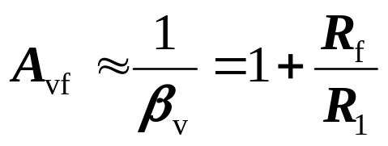
Calculate in an ideal feedback circuit
2. Approximate Calculation
（1）Series-shunt
A. Since
and
thus
Feedback Configuration?
B. Using
thus

Slide 13


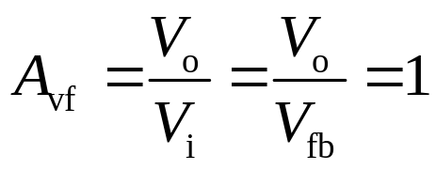
Since
and
thus

Slide 14
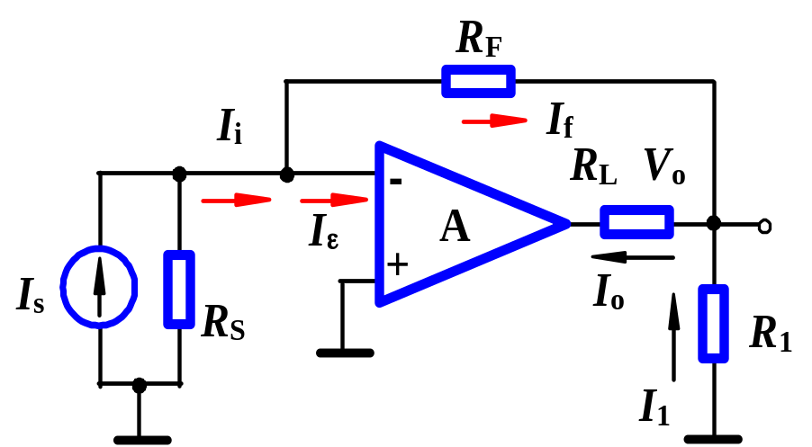
(+)
(+)
Step 1: feedback network
(−)
Network_ R_{F}.
Step 2: positive or negative feedback
Instantaneous polarity_neg.
Step 3: determine input connection
KCL can be used, or input and feedback signal are at same terminals. →shunt.
Step 4: determine output connection
When R_{L}=0, → I_{o}≠0, → I_{f}≠0, →series.
The circuit is a shunt-series configuration.

Slide 15
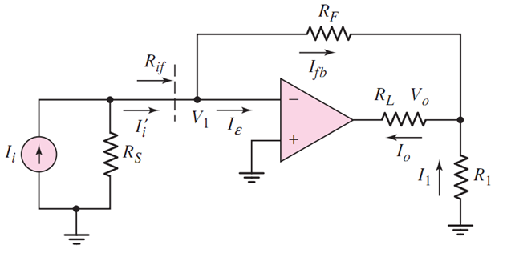
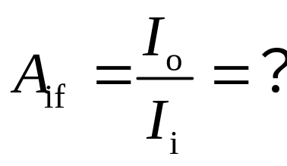


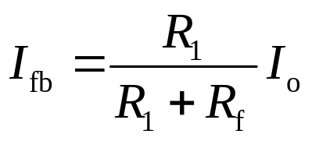
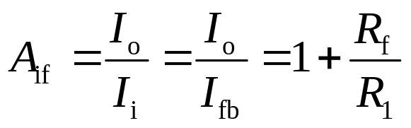
Since
and
thus

Slide 16
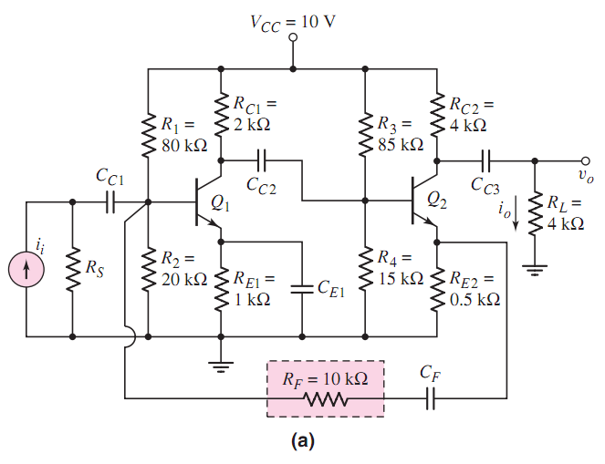
Shunt
－
＋
＋
－
－
—
Series
Neg.

Slide 17

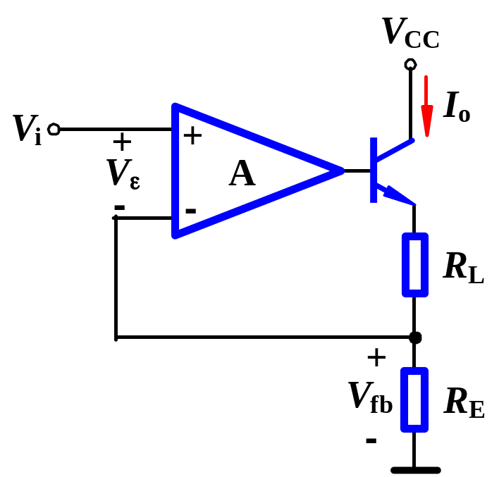
Step 1: feedback network
(+)
(+)
Network_ R_{E}.
(+)
Step 2: positive or negative feedback
negative
(+)
Step 3: determine input connection
series
Step 4: determine output connection
When R_{L}=0, I_{o}≠0, → V_{f} is directly proportional to I_{o}, → V_{f} ≠0, →series.
The circuit is a series-series configuration.

Slide 18
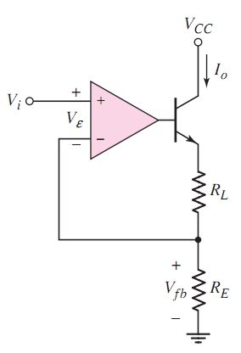
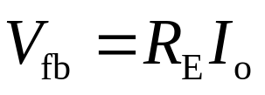
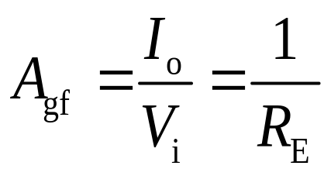
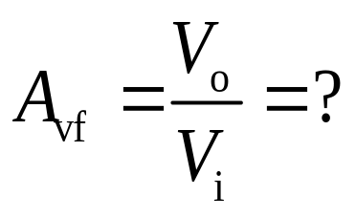
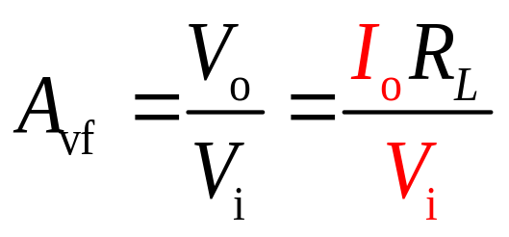
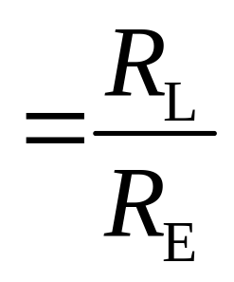
Since
and
thus

Slide 19
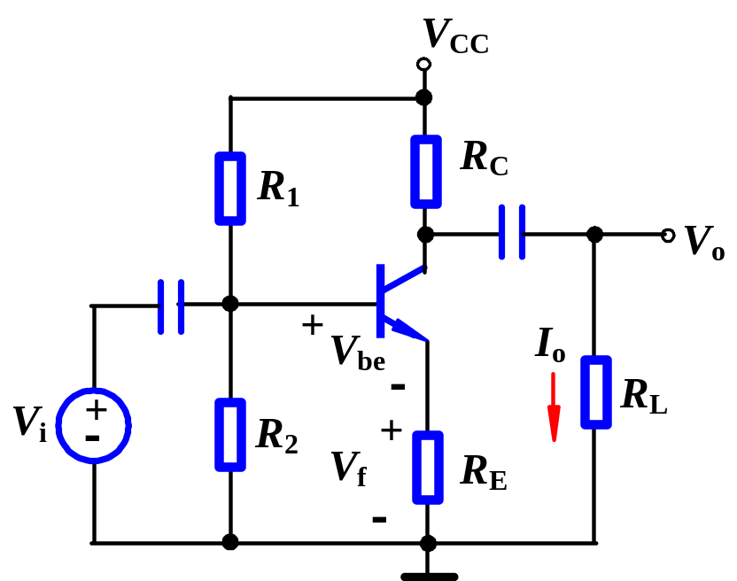
Step 1: feedback network
Network_ R_{E}.
(−)
(+)
Step 2: positive or negative feedback
negative
(+)
Step 3: determine input connection
series
Step 4: determine output connection
When R_{L}=0, I_{o}≠0, → V_{f} ≠0, →series.
The circuit is a series-series configuration.

Slide 20
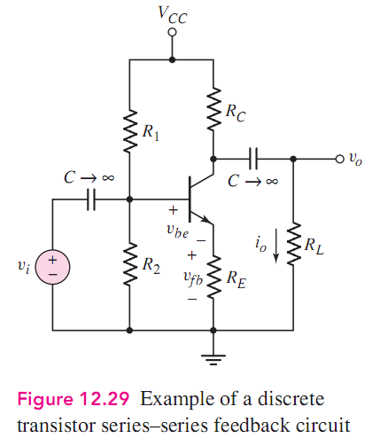

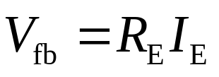
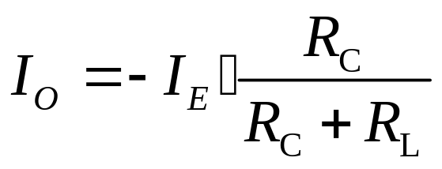
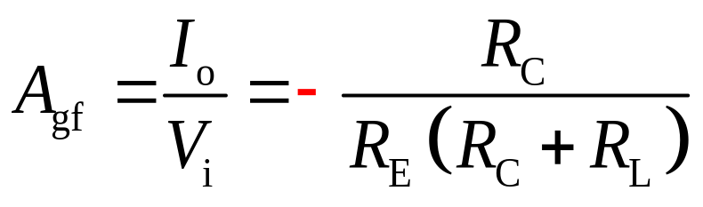
Since
and

Slide 21

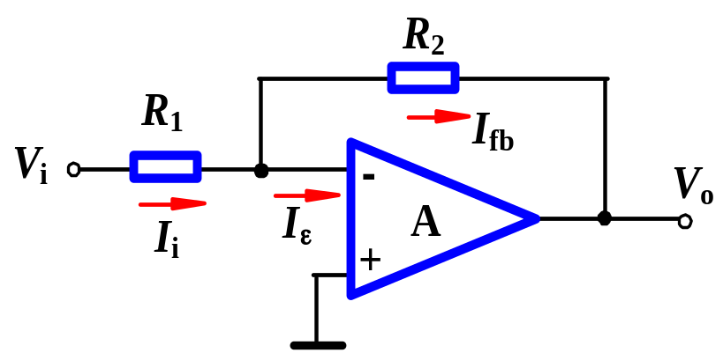
Step 1: feedback network
(+)
(+)
(−)
Network_ R₂.
Step 2: positive or negative feedback
negative
Step 3: determine input connection
shunt.
Step 4: determine output connection
When V_{o}=0, → I_{f} is directly proportional to V_{o}, → I_{f} =0, →shunt.
The circuit is a shunt-shunt configuration.

Slide 22
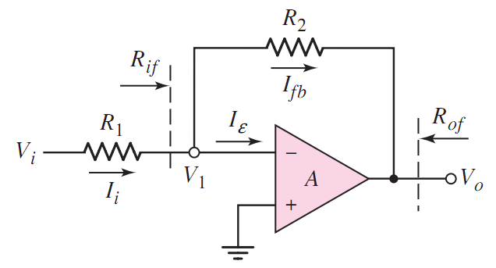

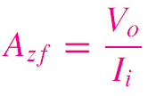


0

Slide 23
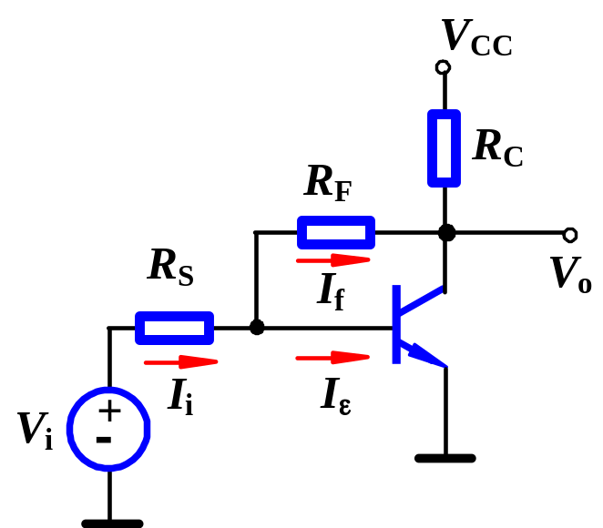
Step 1: feedback network
Network_ R_{F}.
(−)
(+)
Step 2: positive or negative feedback
Negative
Step 3: determine input connection
shunt
Step 4: determine output connection
When V_{o}=0, I_{f} is directly proportional to V_{o}, → I_{f}=0, →shunt.
The circuit is a shunt-shunt configuration.

Slide 24
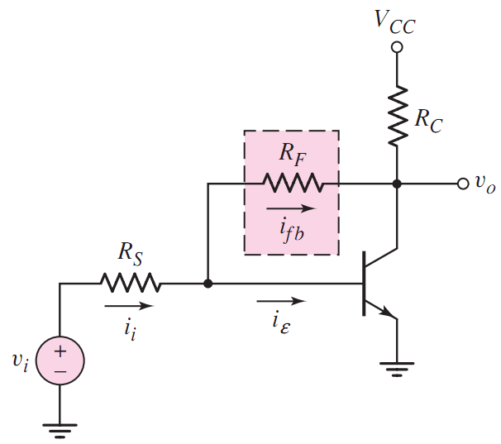

0

Slide 25

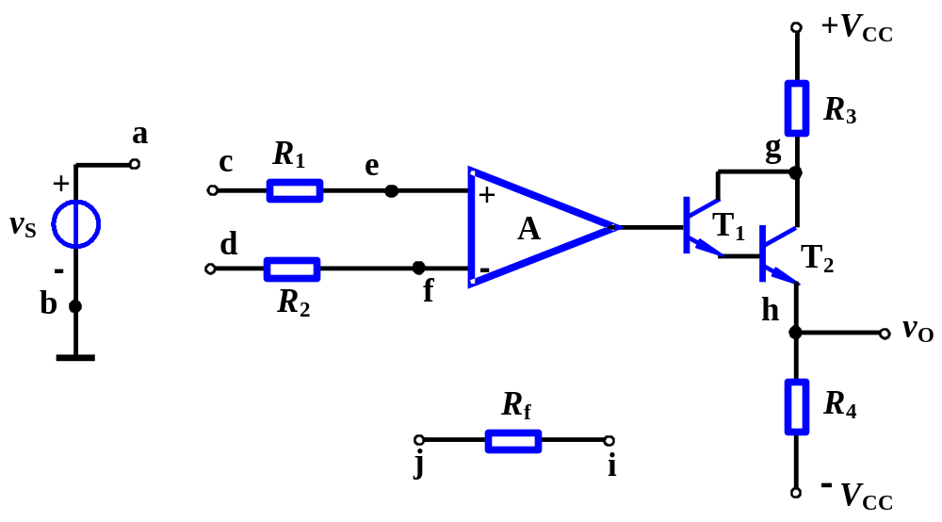
Example
Design: (1) Negative series-shunt circuit
Sol:
Positive feedback
(+)
(−)
(−)
(+)
(−)

Slide 26



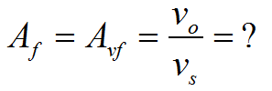
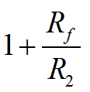
Example
Design: (1) Negative series-shunt circuit
Sol:
Negative series-shunt
(+)
(+)
(+)
(+)
(+)

Slide 27
Example
Design: (2) Negative shunt-shunt circuit
Sol:
Positive feedback
(+)
(+)
(+)
(+)
(+)

Slide 28
Example
Design: (2) Negative shunt-shunt circuit
Sol:
Negative shunt-shunt
(+)
(−)
(+)
(−)
(−)

Slide 29
Example
Design: (3) series-series
Sol:
series-series
(+)
(+)
(+)
(−)
(+)

Slide 30
Example
Design: (4) shunt-series
Sol:
shunt-series
(+)
(−)
(+)
(−)
(+)

Slide 31
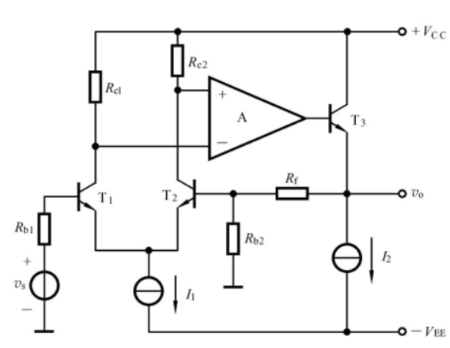
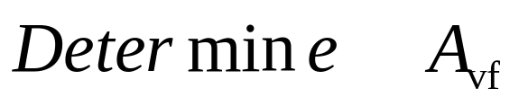






Examples
Sol：
Feedback Configuration?
Series-shunt

Slide 32





Example 12.4.3
Analyze circuit and determine voltage gain
Sol: (1) A₁ and A₂ constitute basic amp. A₃ and some resistors constitute feedback network.
(2) When |1+Aβ|>>1, Virtual open and Virtual short exist.
Feedback Configuration?
Series-Shunt

Slide 33


Example 12.4.3
Sol:
feedback transfer function
Closed-loop voltage gain

Slide 34





Examples
Closed- loop gain
Shunt shunt

Slide 35







Examples

Slide 36








Examples
i_{O}
v_{F}
v_{O}
v_{I}
v_{R}
Series series
Closed- loop gain
Closed-loop
Voltage gain

Slide 37







Examples
Series - Series
(+)
(-)
(+)
(+)
and：
(+)
then：
Closed-loop gain
Closed-loop
Voltage gain

Slide 38



Examples
Series shunt

Slide 39

The circuit is shown as figure,
Determine the feedback configuration.
Give out the expression of the closed-loop gain.
If the A_{vf}=-51, determine the value of the resistor R_{f}.
If the amount of feedback(|1+Aβ |) becomes larger, how to adjust the value of the resistor R_{f}.
Example

Slide 40
Determine the feedback configuration
(-)
(-)
(+)
(-)
(-)
(-)
(-)
(+)
Shunt Shunt

Slide 41

the expression of the closed-loop gain
0

Slide 42





Slide 43





Slide 44
If the amount of feedback |1+AF | becomes larger,
how to adjust the value of the resistor R_{f}

Slide 45




Slide 46
Questions
and
Answers

